Slide 1
eMployee attrition analysis
By,
Kalaivani Lakshmanan

Slide 2
Objective
Employee attrition analytics is the process of analyzing data to determine the causes of employee turnover in an organization.
Employee attrition analytics is specifically focused on identifying why employees voluntarily leave, what might have prevented them from leaving, and how we can use data to predict attrition risk.

Slide 3
Problem Statement
XYZ company which was established a few years back is facing around a 15% attrition rate for a couple of years. And it's majorly affecting the company in many aspects.
In order to understand why employees are leaving the company and reduce the attrition rate XYZ company has approached an HR analytics consultancy for analyzing the data they have.
Play the HR analyst role in this project and build a dashboard which can help the organization in making data-driven decisions.

Slide 4
Approach
Used Python for Data Analysis.
Used Tableau for Data Visualization.

Slide 5
Quick Insights from cleaned dataset
Total Employee Count - 4,300
Male - 2,571
Female - 1,729
Attrition Count - 695
Attrition Rate – 16.16%

Slide 6
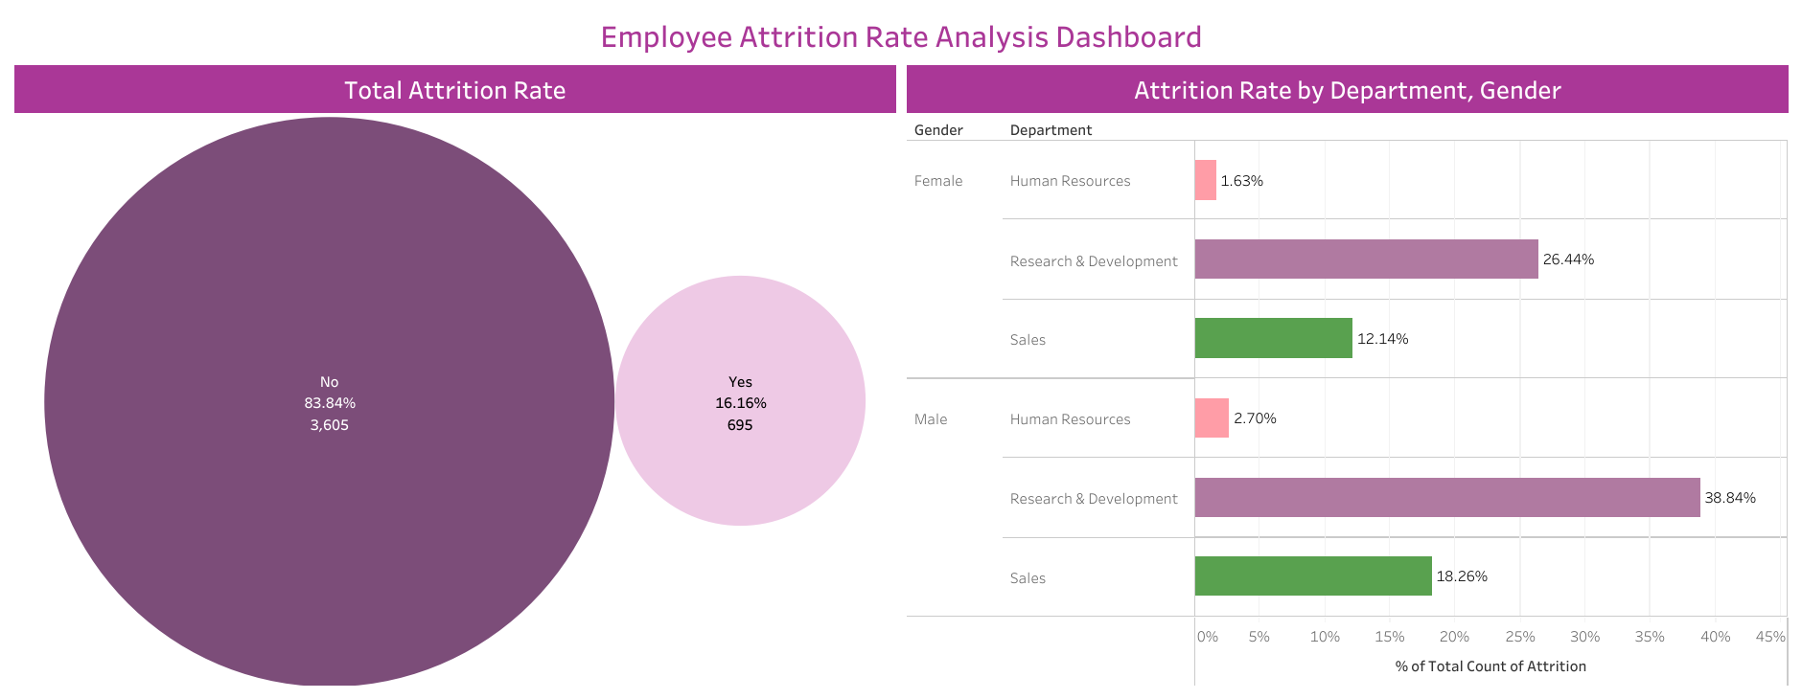

Slide 7
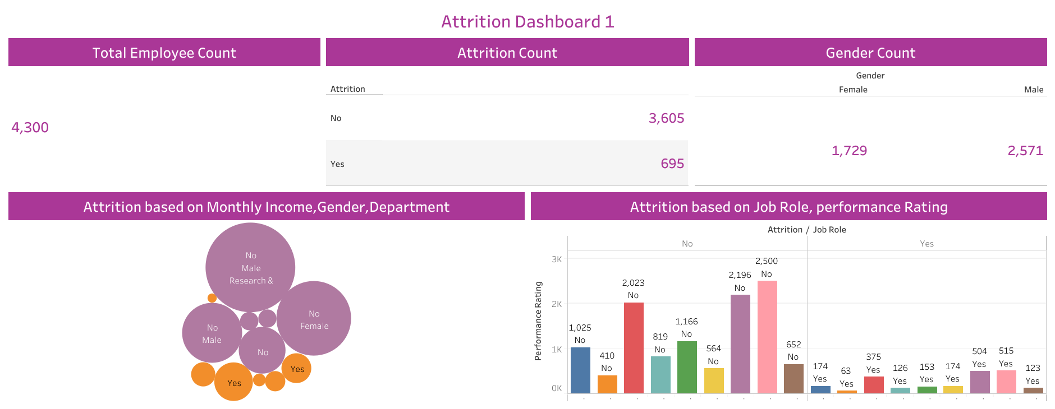

Slide 8
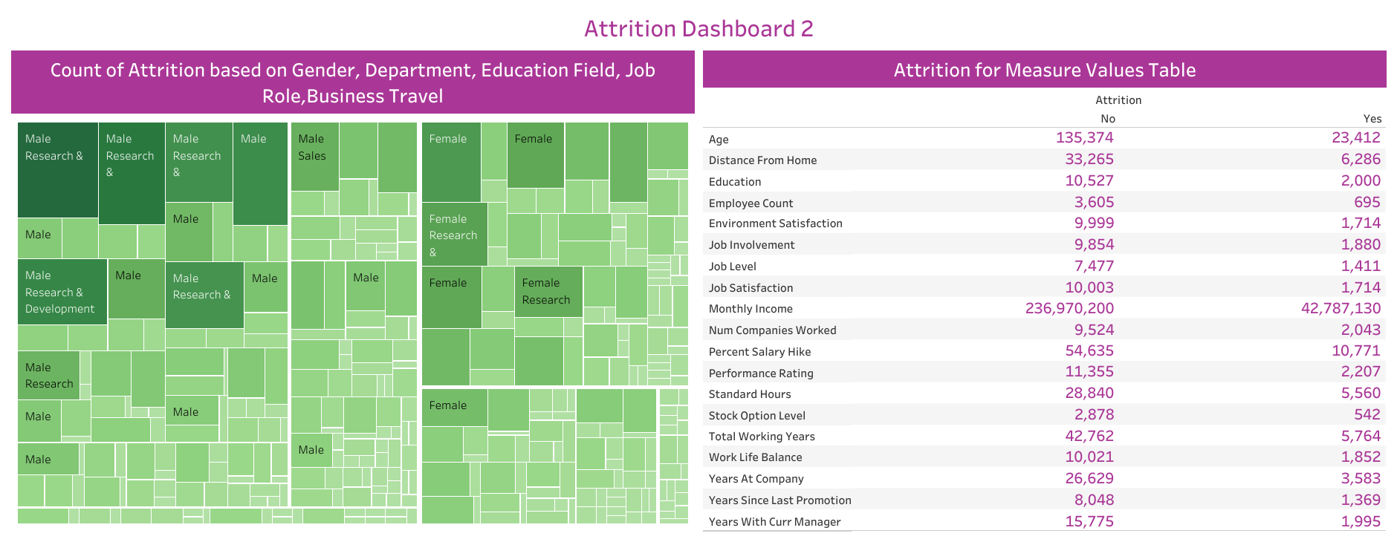

Slide 9
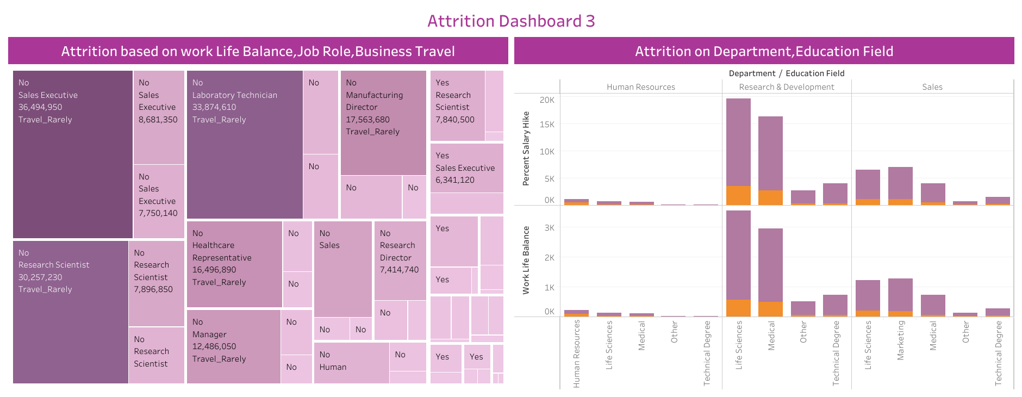

Slide 10
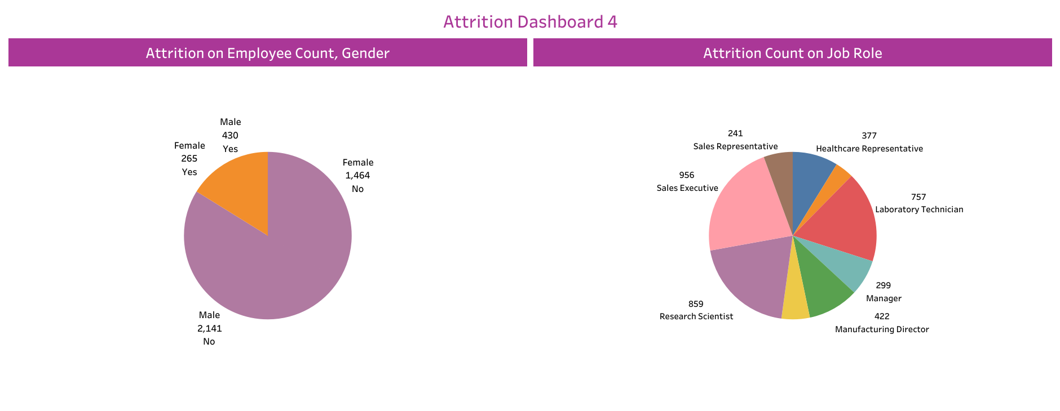

Slide 11
Key Findings
Attrition Rate is 16.16%.
Total Employee Count is 4,300. Attrition Count is 695. Among those, Male Attrition Count – 430, Female Attrition Count – 265.
Attrition is more in the Research & Development Department with Gender – Male, Education Field – Life Sciences, Job Role – Sales Executive.
Attrition is more for the people who has business travel frequently and who has low work life balance.
Attrition is more for the people who has low performance rating and low job satisfaction.

Slide 12
Thank You

